Slide 1
Machine Learning

Slide 2
What is machine learning (ML)?
Machine learning is a subset of artificial intelligence that enables a system to autonomously learn and improve using neural networks and deep learning, without being explicitly programmed, by feeding it large amounts of data.
Machine learning allows computer systems to continuously adjust and enhance themselves as they accrue more “experiences.” Thus, the performance of these systems can be improved by providing larger and more varied datasets to be processed.

Slide 3
Importance of machine learning
The rate of data generation is accelerating, creating more data than ever before, and machine learning helps make it possible to analyze and find value in this vast amount of data.
As such, machine learning is opening an entirely new realm of what humans can do with computers and other machines.
Machine learning helps businesses with important functions like fraud detection, identifying security threats, personalization and recommendations, automated customer service through chatbots, transcription and translation, data analysis, and more.
Machine learning is also driving the exciting innovation of tomorrow, such as autonomous vehicles, drones, and airplanes, augmented and virtual reality, and robotics.

Slide 4
What is the difference between ML, AI, and DL?
Artificial intelligence is a large and complicated field with an extended ecosystem of terms, phrases, and concepts that can be intimidating when bandied about by technologists and other experts.
Artificial intelligence is often used in popular culture as a catch-all word to mean any type of smart machine.
In reality, artificial intelligence, machine learning, and deep learning are distinct terms with subtle differences.

Slide 5
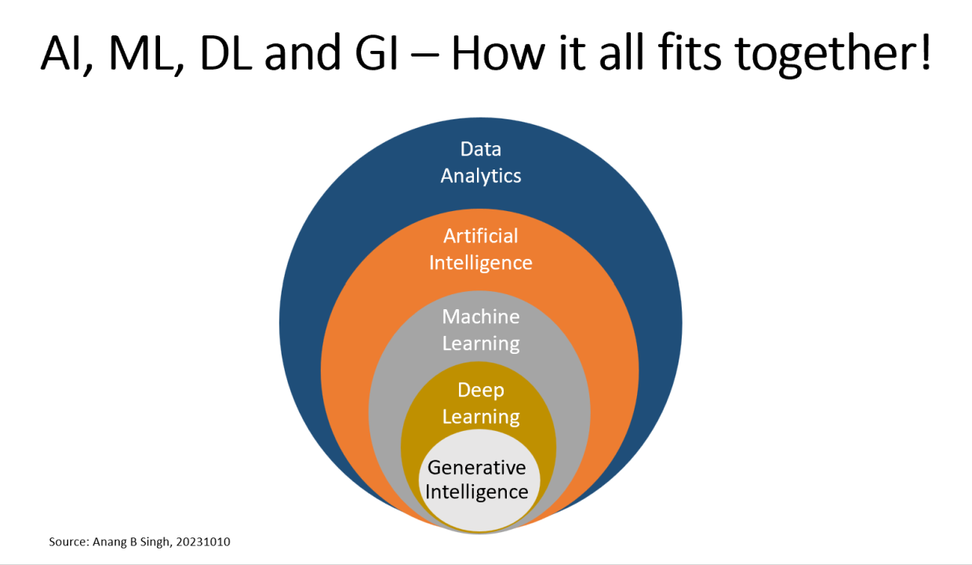
Deep learning vs machine learning vs artificial intelligence
Machine learning is a subset of artificial intelligence. In turn, deep learning is a subset of machine learning.

Slide 6
Data Analytics (DA)
Data analytics is the process of examining, cleaning, transforming, and interpreting data to discover useful insights and support decision-making.
Example:
Analyzing customer purchase data to identify which products are the most popular among customers, leading to targeted marketing strategies.

Slide 7
Artificial Intelligence (AI)
Artificial Intelligence encompasses various techniques, including machine learning and deep learning, to create systems that mimic human-like intelligence, reasoning, and problem-solving.
Example:
In the field of healthcare, AI-powered chatbots are used to provide instant medical advice to patients.
These chatbots analyze symptoms and medical history to offer preliminary diagnoses and recommend appropriate actions, improving access to healthcare information.

Slide 8
Machine Learning (ML)
ML is a subset of a AI that involves the use of algorithms to enable computers to learn from data and make predictions or decisions.
It can be categorized into three main types:
Supervised Machine Learning (SML):
Supervised learning is a machine learning model that uses labeled training data (structured data) to map a specific input to an output. In supervised learning, the output is known (such as recognizing a picture of an apple) and the model is trained on data of the known output. In simple terms, to train the algorithm to recognize pictures of apples, feed it pictures labeled as apples.
The most common supervised learning algorithms used today include:
Linear regression
Polynomial regression
K-nearest neighbors
Naive Bayes
Classification
Decision trees
Example:
Training a model to predict patient readmission in healthcare based on historical patient data and diagnosis codes, helping hospitals allocate resources effectively.

Slide 9
Machine Learning (ML)
Unsupervised Machine Learning (UML)
Unsupervised learning is a machine learning model that uses unlabeled data (unstructured data) to learn patterns.
Unlike supervised learning, the output is not known ahead of time. Rather, the algorithm learns from the data without human input (thus, unsupervised) and categorizes it into groups based on attributes.
For instance, if the algorithm is given pictures of apples and bananas, it will work by itself to categorize which picture is an apple and which is a banana.
Unsupervised learning is good at descriptive modeling and pattern matching.
The most common unsupervised learning algorithms used today include:
Fuzzy means
K-means clustering
Hierarchical clustering
Principal component analysis
Partial least squares
Example: Clustering news articles based on their content to automatically group similar articles together for easier content organization and recommendation.
A mixed approach machine learning called semi-supervised learning is also often employed, where only some of the data is labeled. In semi-supervised learning, the algorithm must figure out how to organize and structure the data to achieve a known result. For instance, the machine learning model is told that the end result is an apple, but only some of the training data is labeled as an apple.

Slide 10
Machine Learning (ML)
Reinforcement Machine Learning (RML)
Reinforcement learning is a machine learning model that can be described as “learn by doing” through a series of trial and error experiments. An “agent” learns to perform a defined task through a feedback loop until its performance is within a desirable range. The agent receives positive reinforcement when it performs the task well and negative reinforcement when it performs poorly.
Example:
Training a robot to navigate a maze autonomously, where it learns to avoid obstacles and reach a target location by receiving rewards for successful navigation.
An example of reinforcement learning is when Google researchers taught a reinforcement learning algorithm to play the game Go. The model had no prior knowledge of the rules of Go and simply moved pieces at random and “learned” the best results as the algorithm was trained, to the point that the machine learning model could beat a human player at the game.

Slide 11
Deep Learning (DL)
Deep learning is a subfield of machine learning that focuses on neural networks with many layers (deep neural networks).
It excels at tasks involving unstructured data like images, audio, and natural language.
Artificial Neural Networks (ANNs)
ANNs are a fundamental component of deep learning.
They are composed of interconnected nodes, mimicking the structure of the human brain.
Deep neural networks consist of many layers, enabling them to capture complex patterns in data.
Example:
Using a deep neural network for image recognition to detect and classify diseases in medical images, aiding in early diagnosis and treatment.

Slide 12
Deep Learning (DL)
Convolutional Neural Networks (CNNs)
CNNs are a specialized type of deep neural network designed for image and spatial data.
They use convolutional layers to automatically learn features from images.
Example:
Training a CNN for autonomous driving to detect pedestrians, traffic signs, and other vehicles in real-time, ensuring safe navigation.

Slide 13
Deep Learning (DL)
Recurrent Neural Networks (RNNs)
RNNs are used for sequential data and have connections that loop back on themselves, allowing them to maintain information about previous inputs. They are often used in tasks like natural language processing and time series analysis.
Example:
Implementing an RNN-based chatbot that can understand and generate human-like responses in customer support interactions.

Slide 14
Generative Intelligence (GAI)
Generative Intelligence is a specialized field within AI that focuses on creating systems capable of generating new and creative content, such as text, images, or music, in a human-like manner.
Generative Adversarial Networks (GANs):
GANs consist of two neural networks, a generator, and a discriminator, that compete. GANs are widely used for tasks like image generation and style transfer.
Example: Using GANs to create realistic, high-resolution artwork or to generate synthetic data for training machine learning models when real data is scarce.

Slide 15
Generative Intelligence (GAI)
Variational Autoencoders (VAEs)
VAEs are used for generating data by learning a probabilistic distribution of the data. They are often used in applications like image generation and data compression.
Example:
Employing VAEs to generate unique, personalized fashion designs for a virtual clothing try-on app, enhancing the user experience.

Slide 16
Generative Intelligence (GAI)
Transformers
Transformers are a class of models that excel in tasks involving sequences, such as language translation and text generation. They have become a fundamental architecture in natural language processing.
Example:
Training a transformer-based language model for automatic language translation, enabling real-time translation of spoken conversations during international business meetings.

Slide 17
How does machine learning work?
Machine learning works by training algorithms on sets of data to achieve an expected outcome such as identifying a pattern or recognizing an object.
Machine learning is the process of optimizing the model so that it can predict the correct response based on the training data samples.
Assuming the training data is of high quality, the more training samples the machine learning algorithm receives, the more accurate the model will become.
The algorithm fits the model to the data during training, in what is called the “fitting process.” This process involves using a loss function to measure the model's errors, and an optimization technique, like gradient descent, to adjust the model's parameters and minimize those errors.
If the outcome does not fit the expected outcome, the algorithm is re-trained again and again until it outputs the accurate response.
In essence, the algorithm learns from the data and reaches outcomes based on whether the input and response fit with a line, cluster, or other statistical correlation.
Notes:
Assuming the training data is of high quality, the more training samples the machine learning algorithm receives, the more accurate the model will become. The algorithm fits the model to the data during training, in what is called the “fitting process.”
This process involves using a loss function to measure the model's errors, and an optimization technique, like gradient descent, to adjust the model's parameters and minimize those errors. If the outcome does not fit the expected outcome, the algorithm is re-trained again and again until it outputs the accurate response. In essence, the algorithm learns from the data and reaches outcomes based on whether the input and response fit with a line, cluster, or other statistical correlation.

Slide 18
Types of machine learning
When talking about different types of machine learning, we're really talking about the training models used.
In broad strokes, there are four kinds of models used in machine learning.
Supervised learning is a machine learning model that uses labeled training data (structured data) to map a specific feature to a label. In supervised learning, the output is known (such as recognizing a picture of an apple) and the model is trained on data of the known output. In simple terms, to train the algorithm to recognize pictures of apples, feed it pictures labeled as apples.
The most common supervised learning algorithms used today include:
Linear regression
Polynomial regression
K-nearest neighbors
Naive Bayes
Decision trees

Slide 19
Types of machine learning
Unsupervised learning is a machine learning model that uses unlabeled data (unstructured data) to learn patterns. Unlike supervised learning, the “correctness” of the output isn't known ahead of time. Rather, the algorithm learns from the data without human input (and is thus, unsupervised) and categorizes it into groups based on attributes.
For example, if the algorithm is given pictures of apples and bananas, it will work by itself to categorize which picture is an apple and which is a banana. Unsupervised learning is good at descriptive modeling and pattern matching.
The most common unsupervised learning algorithms used today include:
Fuzzy means
K-means clustering
Hierarchical clustering
Partial least squares

Slide 20
Types of machine learning
There’s also a mixed approach to machine learning called semi-supervised learning in which only some data is labeled.
In semi-supervised learning, the algorithm must figure out how to organize and structure the data to achieve a known result.
For instance, the machine learning model is told that the result is a pear, but only some training data is labeled as a pear.

Slide 21
Types of machine learning
Reinforcement learning is a machine learning model that can be described as “learn by doing” through a series of trial and error experiments.
An “agent” learns to perform a defined task through a feedback loop until its performance is within a desirable range.
The agent receives positive reinforcement when it performs the task well and negative reinforcement when it performs poorly.
An example of reinforcement learning is when Google researchers taught a reinforcement learning algorithm to play the game Go.
The model, which had no prior knowledge of the rules of Go, simply moved pieces at random and “learned” the best moves to make.
The algorithm was trained by positive and negative reinforcement to the point that the machine learning model could beat a human player at the game.four.

Slide 22
Advantages of machine learning
Pattern recognition
The more data consumed by a machine learning algorithm, the better it gets in finding trends and patterns in that data.
For instance, an ecommerce website might use machine learning to understand how people shop on their site and use that information to give people better recommendations or find trend data that can lead to new product opportunities.

Slide 23
Advantages of machine learning
Automation
Machine learning and artificial intelligence can take away much of the dull and dreary work from human workers.
Utilities like robotic process automation can perform some of the tedious business tasks that keep people from performing more meaningful work.
Computer vision and objection detection algorithms can help robots pick and pack items from an assembly line.
Always-on fraud detection and threat-assessment machine learning can find security flaws before they become a problem.

Slide 24
Advantages of machine learning
Continuous improvement
Given the right kinds of data, machine learning algorithms will continue to improve to be faster and more accurate.
This improvement can happen in a few key ways including being retained with new data, and receiving real-world feedback from users.

Slide 25
Potential challenges of machine learning
Bias potential
Machine learning's often only as good as the data it's being fed. If a machine learning algorithm is fed a biased dataset, it'll deliver biased results.
Data acquisition
Machine learning can require a lot of data before it can be useful. As many machine learning use cases are based on supervised learning, acquiring and cleaning structured data to train the algorithms is an important first step, which can be difficult if data resides in a variety of siloed locations within an organization.
Technical expertise required
While machine learning, artificial intelligence, and cloud vendors try to make it as easy as possible to set up and run machine learning algorithms, organizations often need programmers and data scientists to understand and utilize the training algorithms and their results.
Resource intensive
Machine learning can be time consuming, requiring a lot of computing resources and employee hours to begin processing data and achieving results.

Slide 26
Machine learning Use Cases
Robotic process automation (RPA)
RPA combined with machine learning can create intelligent automation that’s capable of automating complex tasks, such as processing mortgage applications.
Google Cloud offers several products that can be used with RPA, including Apigee for API management, AppSheet for low-code development, and Vertex AI for machine learning workflows.
Fraud prevention
Machine learning helps credit card companies and banks review vast amounts of transactional data to identify suspicious activity in real time. reCAPTCHA Enterprise helps protect websites and mobile apps from fraudulent activity. Google Cloud also partners with Swift to create anti-fraud technologies, leveraging advanced AI and federated learning.

Slide 27
Machine learning Use Cases
Customer service
Machine learning applications can include chatbots and automated virtual assistants to automate routine customer service tasks and speed up issue resolution. Dialogflow helps enable the creation of conversational interfaces for websites, mobile apps, and devices. Contact Center AI can also be used to enhance customer service operations.
Sales optimization
Customer data can train machine learning algorithms for customer sentiment analysis, sales forecasting analysis, and customer churn predictions.
Tools like BigQuery for data warehousing, Looker for data visualization, and Vertex AI for building and deploying machine learning models, can help optimize sales processes.

Slide 28
Machine learning Use Cases
Digital marketing
Machine learning enables marketers to identify new customers and to offer the right marketing materials to the right people at the right time. Marketing analytics solutions that integrate with Google Ads and Google Analytics 360, like BigQuery ML and Vertex AI, can be used to build custom machine learning models for personalized marketing.
Security
Machine learning helps enterprises improve their threat analysis capabilities and how they respond to cyberattacks, hackers, and malware. Google Cloud Security Command Center (SCC) offers a consolidated view of security and risk across Google Cloud resources. Google Cloud Armor helps protect web applications from threats, and Chronicle SIEM aids in threat detection and investigation.

Slide 29
Supervised Learning
Supervised learning is a machine learning approach where an algorithm learns from a labeled training dataset to make predictions or classifications.
It's like teaching a child by showing them examples with correct answers, enabling them to identify similar items later.
Labeled Data:
Supervised learning relies on datasets where both the input (features) and the desired output (labels) are known.
Training:
The algorithm learns the relationship between the inputs and outputs from the labeled data.
Prediction/Classification:
Once trained, the algorithm can predict the output for new, unseen input data or classify it into predefined categories.

Slide 30
Supervised Learning – How it works
Data Preparation:
A dataset is gathered and labeled manually, with each data point having associated input features and the correct output (label).
Model Training:
The algorithm analyzes the training data to identify patterns and relationships between inputs and outputs.
Model Evaluation:
The trained model's performance is evaluated using a separate test dataset to assess its accuracy in making predictions or classifications.
Prediction/Classification:
The model can then be used to predict outputs for new, unseen data.

Slide 31
Types of Supervised Learning
Regression:
Predicting a continuous numerical value (e.g., predicting house prices based on features like size, location, etc.).
Classification:
Assigning data points to predefined categories (e.g., classifying emails as spam or not spam).
Examples of Supervised Learning Applications:
Image Recognition: Classifying images of cats, dogs, or other objects.
Spam Filtering: Identifying and filtering out unwanted emails.
Medical Diagnosis: Assisting in diagnosing diseases based on patient data.
Fraud Detection: Identifying fraudulent transactions in financial data.
Predictive Maintenance: Estimating the remaining life of equipment based on usage patterns.

Slide 32
Regression
The term regression is used when you try to find the relationship between variables.
In Machine Learning, and in statistical modeling, that relationship is used to predict the outcome of future events.

Slide 33
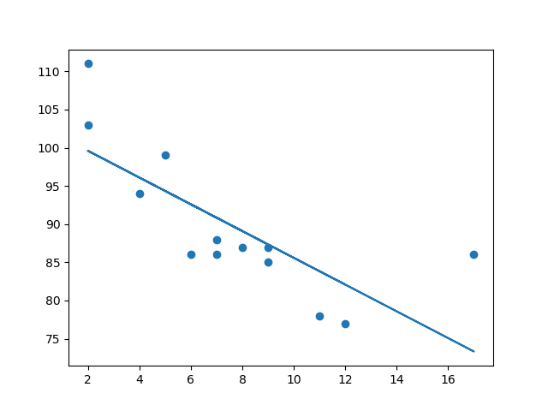
Linear Regression
Linear regression uses the relationship between the data-points to draw a straight line through all them.
This line can be used to predict future values.
In Machine Learning, predicting the future is very important.

Slide 34
How Does it Work?
Python has methods for finding a relationship between data-points and to draw a line of linear regression.
We will show you how to use these methods instead of going through the mathematic formula.
In the example below, the x-axis represents age, and the y-axis represents speed.
We have registered the age and speed of 13 cars as they were passing a tollbooth.
Let us see if the data we collected could be used in a linear regression:
import matplotlib.pyplot as plt
x = [5,7,8,7,2,17,2,9,4,11,12,9,6]
y = [99,86,87,88,111,86,103,87,94,78,77,85,86]
plt.scatter(x, y)
plt.show()

Slide 35
How Does it Work?
Example: Import scipy and draw the line of Linear Regression:
#Import Libraries
import matplotlib.pyplot as plt from scipy import stats
#Create the arrays that represent the values of the x and y axis: x = [5,7,8,7,2,17,2,9,4,11,12,9,6] y = [99,86,87,88,111,86,103,87,94,78,77,85,86]
#Execute a method that returns some important key values of Linear Regression: slope, intercept, r, p, std_err = stats.linregress(x, y)
#Create a function that uses the slope and intercept values to return a new value. This new value represents where on the y-axis the corresponding x value will be placed:
def myfunc(x): return slope * x + intercept
#Run each value of the x array through the function. This will result in a new array with new values for the y-axis: mymodel = list(map(myfunc, x))
#Draw the original scatter plot plt.scatter(x, y)
#Draw the line of linear regression: plt.plot(x, mymodel)
#Display the diagram: plt.show()

Slide 36
R for Relationship
It is important to know how the relationship between the values of the x-axis and the values of the y-axis is, if there are no relationship the linear regression can not be used to predict anything.
This relationship - the coefficient of correlation - is called r.
The r value ranges from -1 to 1, where 0 means no relationship, and 1 (and -1) means 100% related.
Python and the Scipy module will compute this value for you, all you have to do is feed it with the x and y values.

Slide 37
How well does my data fit in a linear regression?
from scipy import stats
x = [5,7,8,7,2,17,2,9,4,11,12,9,6]
y = [99,86,87,88,111,86,103,87,94,78,77,85,86]
slope, intercept, r, p, std_err = stats.linregress(x, y)
print(r)
Note: The result -0.76 shows that there is a relationship, not perfect, but it indicates that we could use linear regression in future predictions.

Slide 38
Predict Future Values
Now we can use the information we have gathered to predict future values.
Example: Let us try to predict the speed of a 10 years old car.
To do so, we need the same myfunc() function from the example above:
Predict the speed of a 10 years old car:
from scipy import stats x = [5,7,8,7,2,17,2,9,4,11,12,9,6] y = [99,86,87,88,111,86,103,87,94,78,77,85,86] slope, intercept, r, p, std_err = stats.linregress(x, y) def myfunc(x): return slope * x + intercept speed = myfunc(10) print(speed)

Slide 39
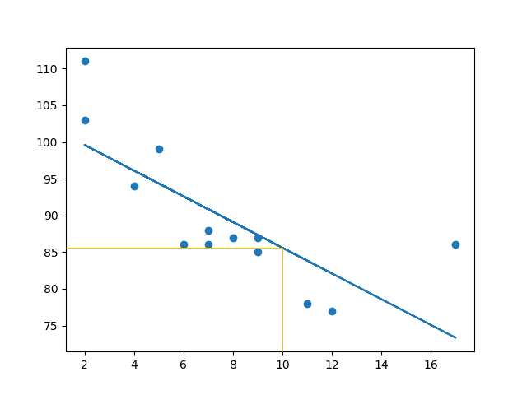
Predict Future Values
The example predicted a speed at 85.6, which we also could read from the diagram:

Slide 40
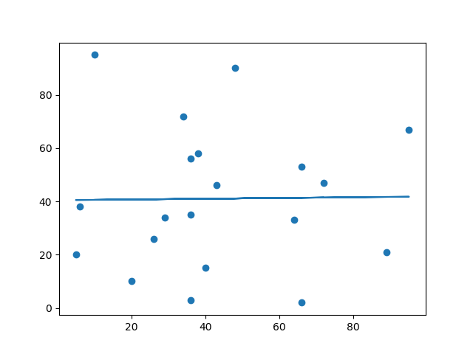
Bad Fit?
Let us create an example where linear regression would not be the best method to predict future values.
Example
These values for the x- and y-axis should result in a very bad fit for linear regression:
import matplotlib.pyplot as plt from scipy import stats x = [89,43,36,36,95,10,66,34,38,20,26,29,48,64,6,5,36,66,72,40] y = [21,46,3,35,67,95,53,72,58,10,26,34,90,33,38,20,56,2,47,15] slope, intercept, r, p, std_err = stats.linregress(x, y) def myfunc(x): return slope * x + intercept mymodel = list(map(myfunc, x)) plt.scatter(x, y) plt.plot(x, mymodel) plt.show()

Slide 41
Bad Fit ?
And the r for relationship?
Example
You should get a very low r value.
import numpy
from scipy import stats
x = [89,43,36,36,95,10,66,34,38,20,26,29,48,64,6,5,36,66,72,40]
y = [21,46,3,35,67,95,53,72,58,10,26,34,90,33,38,20,56,2,47,15]
slope, intercept, r, p, std_err = stats.linregress(x, y)
print(r)
Note:The result: 0.013 indicates a very bad relationship, and tells us that this data set is not suitable for linear regression.

Slide 42
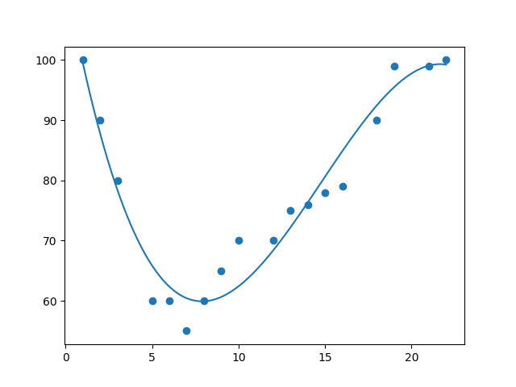
Machine Learning - Polynomial Regression
Polynomial Regression
If your data points clearly will not fit a linear regression (a straight line through all data points), it might be ideal for polynomial regression.
Polynomial regression, like linear regression, uses the relationship between the variables x and y to find the best way to draw a line through the data points.

Slide 43
How does it work ?
Python has methods for finding a relationship between data-points and to draw a line of polynomial regression. We will show you how to use these methods instead of going through the mathematic formula.
In the example below, we have registered 18 cars as they were passing a certain tollbooth.
We have registered the car's speed, and the time of day (hour) the passing occurred.
The x-axis represents the hours of the day and the y-axis represents the speed:

Slide 44
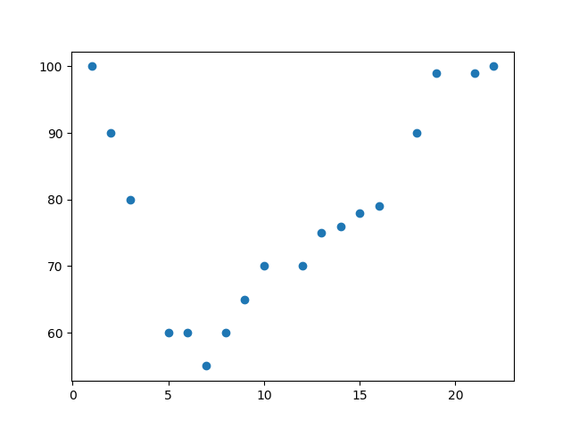
How does it work ?
Start by drawing a scatter plot:
import matplotlib.pyplot as plt
x = [1,2,3,5,6,7,8,9,10,12,13,14,15,16,18,19,21,22]
y = [100,90,80,60,60,55,60,65,70,70,75,76,78,79,90,99,99,100]
plt.scatter(x, y)
plt.show()

Slide 45
How does it work ?
Example
Import numpy and matplotlib then draw the line of Polynomial Regression:
import numpy import matplotlib.pyplot as plt x = [1,2,3,5,6,7,8,9,10,12,13,14,15,16,18,19,21,22] y = [100,90,80,60,60,55,60,65,70,70,75,76,78,79,90,99,99,100] mymodel = numpy.poly1d(numpy.polyfit(x, y, 3)) myline = numpy.linspace(1, 22, 100) plt.scatter(x, y) plt.plot(myline, mymodel(myline)) plt.show()
Notes:
Example Explained
Import the modules you need.
You can learn about the NumPy module in our NumPy Tutorial.
You can learn about the SciPy module in our SciPy Tutorial.
import numpy
import matplotlib.pyplot as plt
Create the arrays that represent the values of the x and y axis:
x = [1,2,3,5,6,7,8,9,10,12,13,14,15,16,18,19,21,22]
y = [100,90,80,60,60,55,60,65,70,70,75,76,78,79,90,99,99,100]
NumPy has a method that lets us make a polynomial model:
mymodel = numpy.poly1d(numpy.polyfit(x, y, 3))
Then specify how the line will display, we start at position 1, and end at position 22:
myline = numpy.linspace(1, 22, 100)
Draw the original scatter plot:
plt.scatter(x, y)
Draw the line of polynomial regression:
plt.plot(myline, mymodel(myline))
Display the diagram:
plt.show()

Slide 46
R-Squared
R-Squared
It is important to know how well the relationship between the values of the x- and y-axis is, if there are no relationship the polynomial regression can not be used to predict anything.
The relationship is measured with a value called the r-squared.
The r-squared value ranges from 0 to 1, where 0 means no relationship, and 1 means 100% related.
Python and the Sklearn module will compute this value for you, all you have to do is feed it with the x and y arrays:

Slide 47
R-Squared Example
How well does my data fit in a polynomial regression?
import numpy
from sklearn.metrics import r2_score
x = [1,2,3,5,6,7,8,9,10,12,13,14,15,16,18,19,21,22]
y = [100,90,80,60,60,55,60,65,70,70,75,76,78,79,90,99,99,100]
mymodel = numpy.poly1d(numpy.polyfit(x, y, 3))
print(r2_score(y, mymodel(x)))
Note: The result 0.94 shows that there is a very good relationship, and we can use polynomial regression in future predictions.

Slide 48
Predict Future Values
Now we can use the information we have gathered to predict future values.
Example: Let us try to predict the speed of a car that passes the tollbooth at around the time 17:00:
To do so, we need the same mymodel array from the example above:
mymodel = numpy.poly1d(numpy.polyfit(x, y, 3))

Slide 49
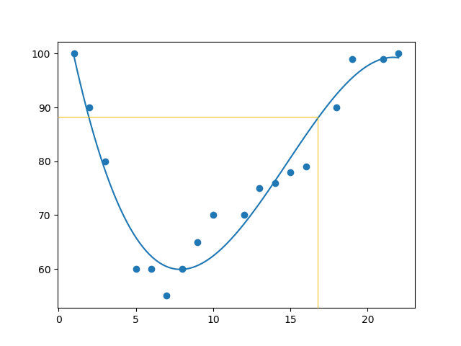
Predict Future Values
Example : Predict the speed of a car passing at 17:00:
import numpy from sklearn.metrics import r2_score x = [1,2,3,5,6,7,8,9,10,12,13,14,15,16,18,19,21,22] y = [100,90,80,60,60,55,60,65,70,70,75,76,78,79,90,99,99,100] mymodel = numpy.poly1d(numpy.polyfit(x, y, 3)) speed = mymodel(17) print(speed)
The example predicted a speed to be 88.87, which we also could read from the diagram:

Slide 50
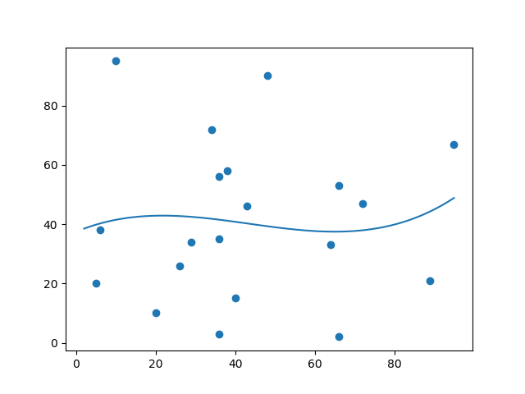
Bad Fit?
Let us create an example where polynomial regression would not be the best method to predict future values.
These values for the x- and y-axis should result in a very bad fit for polynomial regression:
import numpy import matplotlib.pyplot as plt x = [89,43,36,36,95,10,66,34,38,20,26,29,48,64,6,5,36,66,72,40] y = [21,46,3,35,67,95,53,72,58,10,26,34,90,33,38,20,56,2,47,15] mymodel = numpy.poly1d(numpy.polyfit(x, y, 3)) myline = numpy.linspace(2, 95, 100) plt.scatter(x, y) plt.plot(myline, mymodel(myline)) plt.show()

Slide 51
R-Squared Value
Example
We should get a very low r-squared value.
import numpy from sklearn.metrics import r2_score x = [89,43,36,36,95,10,66,34,38,20,26,29,48,64,6,5,36,66,72,40] y = [21,46,3,35,67,95,53,72,58,10,26,34,90,33,38,20,56,2,47,15] mymodel = numpy.poly1d(numpy.polyfit(x, y, 3)) print(r2_score(y, mymodel(x)))
The result: 0.00995 indicates a very bad relationship, and tells us that this data set is not suitable for polynomial regression.

Slide 52
Machine Learning - Multiple Regression
Multiple regression is like linear regression, but with more than one independent value, meaning that we try to predict a value based on two or more variables.
Take a look at the data set below, it contains some information about cars. data.csv
We can predict the CO2 emission of a car based on the size of the engine, but with multiple regression we can throw in more variables, like the weight of the car, to make the prediction more accurate.

Slide 53
How does it work ?
In Python we have modules that will do the work for us. Start by importing the Pandas module.
import pandas from sklearn import linear_model df = pandas.read_csv("data.csv") X = df[['Weight', 'Volume']] y = df['CO2'] regr = linear_model.LinearRegression() regr.fit(X, y) #predict the CO2 emission of a car where the weight is 2300kg, and the volume is 1300cm³: predictedCO2 = regr.predict([[2300, 1300]]) print(predictedCO2)
We have predicted that a car with 1.3 liter engine, and a weight of 2300 kg, will release approximately 107 grams of CO2 for every kilometer it drives.
Notes:
The Pandas module allows us to read csv files and return a DataFrame object.
The file is meant for testing purposes only, you can download it here: data.csv
df = pandas.read_csv("data.csv")
Then make a list of the independent values and call this variable X.
Put the dependent values in a variable called y.
X = df[['Weight', 'Volume']] y = df['CO2']
Tip: It is common to name the list of independent values with a upper case X, and the list of dependent values with a lower case y.
We will use some methods from the sklearn module, so we will have to import that module as well:
from sklearn import linear_model
From the sklearn module we will use the LinearRegression() method to create a linear regression object.
This object has a method called fit() that takes the independent and dependent values as parameters and fills the regression object with data that describes the relationship:
regr = linear_model.LinearRegression() regr.fit(X, y)
Now we have a regression object that are ready to predict CO2 values based on a car's weight and volume:
#predict the CO2 emission of a car where the weight is 2300kg, and the volume is 1300cm³: predictedCO2 = regr.predict([[2300, 1300]])

Slide 54
Coefficient
The coefficient is a factor that describes the relationship with an unknown variable.
Example: if x is a variable, then 2x is x two times. x is the unknown variable, and the number 2 is the coefficient.
In this case, we can ask for the coefficient value of weight against CO2, and for volume against CO2. The answer(s) we get tells us what would happen if we increase, or decrease, one of the independent values.

Slide 55
Coefficient
Example
Print the coefficient values of the regression object:
import pandas from sklearn import linear_model df = pandas.read_csv("data.csv") X = df[['Weight', 'Volume']] y = df['CO2'] regr = linear_model.LinearRegression() regr.fit(X, y) print(regr.coef_)

Slide 56
Coefficient
Result Explained
The result array represents the coefficient values of weight and volume.
Weight: 0.00755095 Volume: 0.00780526
These values tell us that if the weight increase by 1kg, the CO2 emission increases by 0.00755095g.
And if the engine size (Volume) increases by 1cm³, the CO2 emission increases by 0.00780526g.
I think that is a fair guess, but let test it!
We have already predicted that if a car with a 1300cm³ engine weighs 2300kg, the CO2 emission will be approximately 107g.
What if we increase the weight with 1000kg?

Slide 57
Coefficient
Example
Copy the example from before, but change the weight from 2300 to 3300:
import pandas from sklearn import linear_model df = pandas.read_csv("data.csv") X = df[['Weight', 'Volume']] y = df['CO2'] regr = linear_model.LinearRegression() regr.fit(X, y) predictedCO2 = regr.predict([[3300, 1300]]) print(predictedCO2)
We have predicted that a car with 1.3 liter engine, and a weight of 3300 kg, will release approximately 115 grams of CO2 for every kilometer it drives.
Which shows that the coefficient of 0.00755095 is correct:
107.2087328 + (1000 * 0.00755095) = 114.75968

